Slide 1

FLOOD AGREEMENTS 2.0
RESOURCE REVENUE SHARING, INNOVATIVE FINANCE AND ECONOMIC RECONCILIATION IN HYDRO-AFFECTED INDIGENOUS COMMUNITIES IN MANITOBA
PARTIAL REPORT
JULIO LUCCHESI, PhD
MARCH 2019

Slide 2
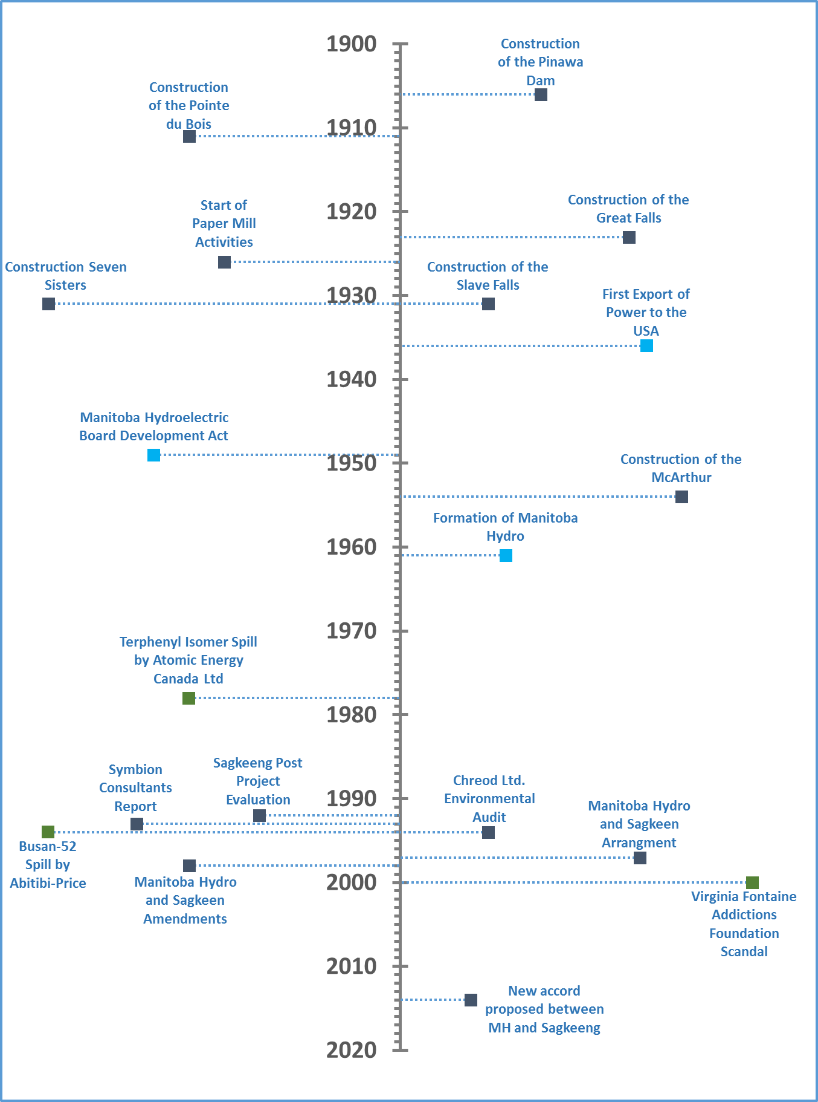
MANITOBA HYDRO AND THE WINNIPEG RIVER

Slide 3
HOW ABOUT A RADICAL, PARADIGMATICAL SHIFT?
SOURCE: MH (PRODUCED BY A.IERVOLINO)

Slide 4
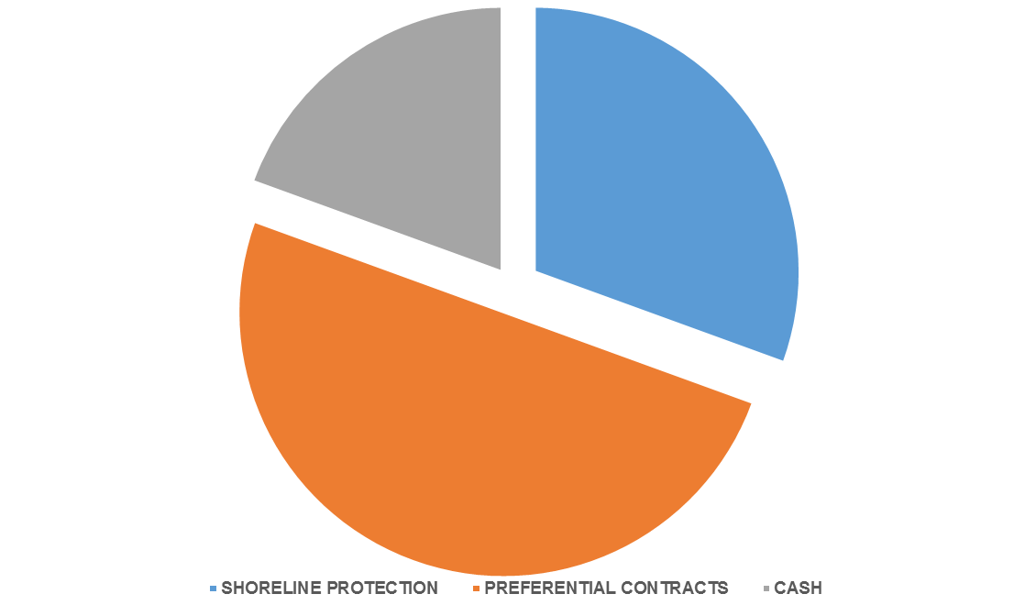
THE DEAL: THE QUALITY AND THE QUANTITY OF RESOURCES
200 MI FOR A 40 YEARS PARTNERSHIP
19.5%
MONETARY
COMMITMENT
38.9
61.1
80.5%
NON-MONETARY
COMMITMENT
100
PROBLEM #1: WE DON’T THINK THIS SHOULD BE IN A COMMUNITY DEAL...
SOURCE: ADAPTED FROM SAGKEENG (2014)

Slide 5
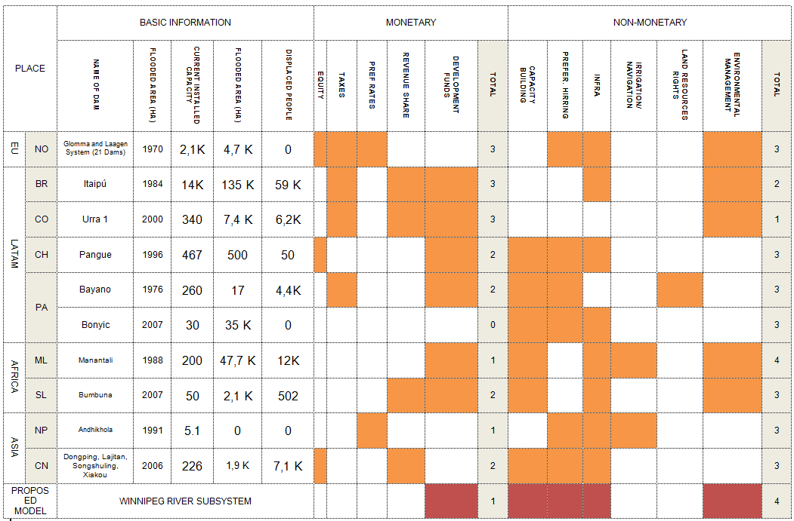
INTERNATIONAL PRACTICES
MH-SAGKEENG DEAL COMPARED WITH JOINT PROJECTS FROM SELECTED COUNTRIES
SOURCE: ADAPTED FROM PAIMENT (2010)

Slide 6
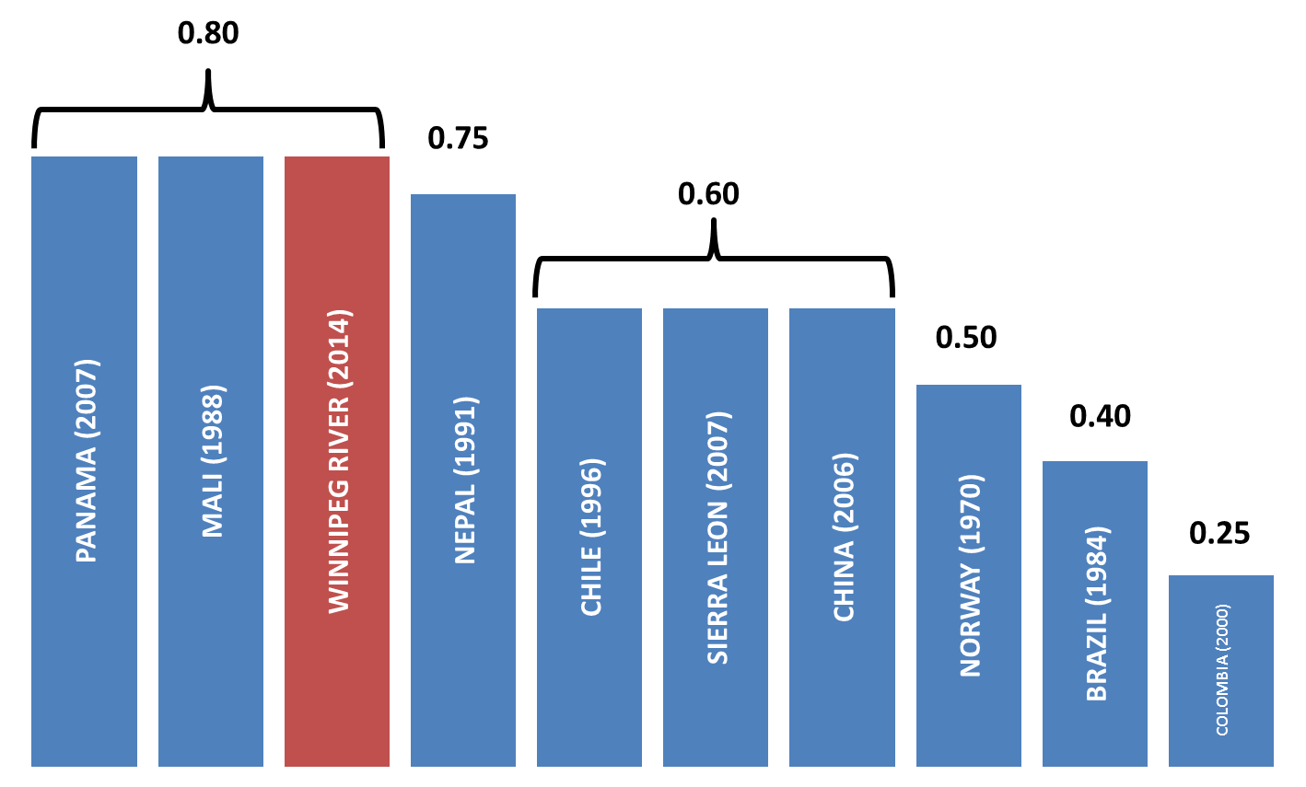
INTERNATIONAL PRACTICES
NON-MONETARY COMMITMENT SCORE (O TO 1)
VALUES CLOSER TO 1 DENOTE FINANCIAL MODELS THAT AVOID DIRECT MONETARY COMMITMENTS.
THROUGH THIS ANALYSIS, IT IS POSSIBLE TO SAY THAT MH 2014 PROPOSITION
(IN THE ABSENCE OF REVENUE SHARING MECHANISMS)
IS OUTDATED.
SOURCE: ADAPTED FROM PAIMENT (2010)

Slide 7
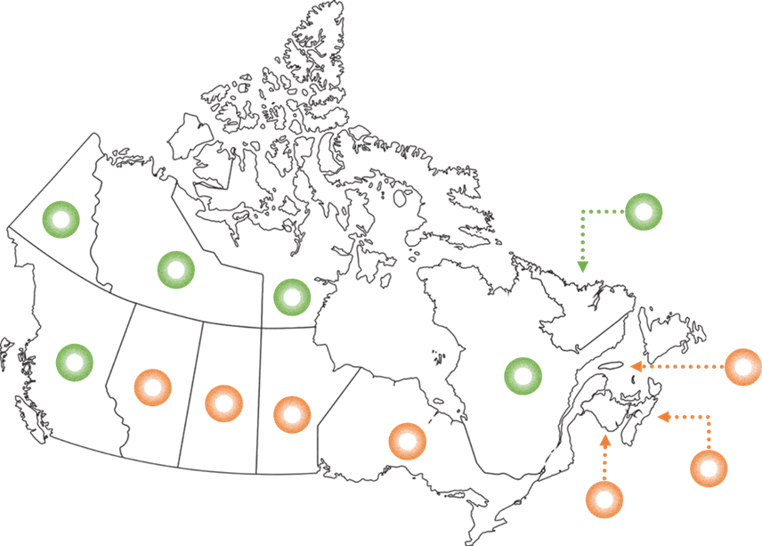
NATIONAL PRACTICES
GOVERNMENTAL RESOURCE REVENUE SHARING (GRRS) BY CANADIAN PROVINCE
YES
NO
SOURCE: ADAPTED FROM PDAC (2014)

Slide 8
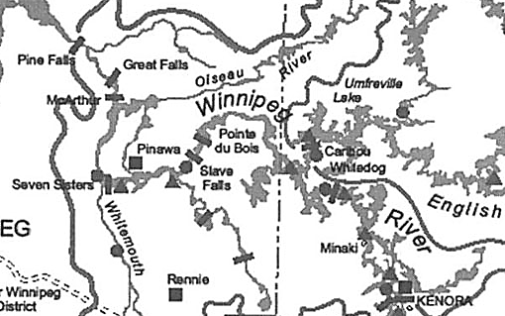
PROBLEM #2: THE PREFERENTIAL CONTRACTS (PART 1)
100 MI REPRESENTS 4.1% OF CAPITAL EXPENDITURE ALREADY EXPECTED TO BE DISIMBURSED BY MH IN ITS ASSETS AT THE WPGRSS UNTIL 2027
CAPACITY BUILDING? QUALITY JOBS?
122 MI
MAJOR OVERHAULS
UNITS 1-4
33 MI
OVERHAUL
UNIT 4
2.1 BI
SPILLWAY REPLACEMENT
TRANSMISSION
POWEHOUSE REBUILD
GS REHABILITATION
126 MI
MAJOR
OVERHAULS
SOURCE: MH (IFF13)

Slide 9
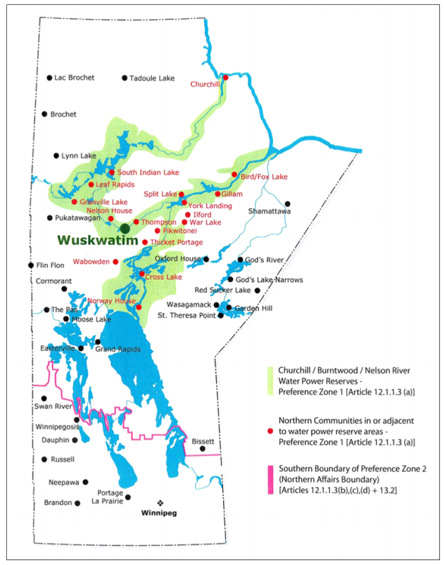

















PROBLEM #2: THE PREFERENTIAL CONTRACTS (PART 2)
PREFERENTIAL CONTRACTS ARE ALREADY A REALITY IN NORTHERN AGREEMENTS

Slide 10
PROBLEM #3: 38.9 CASH OFFER, WHY THIS VALUE?
2014 DEAL CONTRASTED TO 10 ALTERNATIVE RRS MODELS
MODEL | SHORT NAME | DESCRIPTION | COMPENSATES PRE-2017? | PAYMENT VALUES | INSPIRATION
1 | MH/BS1 | MH pays value totalizing 38.9 MI (2017 Value) | No | FIX | MANITOBA Northern Flood Agreement 1977
2 | MH/BS2 | MH pays value equivalent to C$2017 750K | No
3 | BR/FUT | MH pays a value proportionate to its revenue in the WPGRSS | No | VARIABLE | BRAZIL Financial Compensation Law 7990/1989
4 | BR/COM | MH pays a value proportionate to its revenue in the WPGRSS + 40 contribution from pre-2017 activities | Yes
5 | MB/FUT | MH pays to SGK water rentals proportional to its usage of WPGRSS resources | No | VARIABLE | MANITOBA Water Act C.C.S.M. c. W60 1988
6 | MB/COM | MH pays to SGK water rentals proportional to its usage of WPGRSS resources + 40 contribution from pre-2017 activities | Yes
7 | QC/FUT-F | MH+MB commit to a fix amount on similar terms as the ACNR | No | FIX | QUEBEC Paix des Braves Décret Nº 289/2002
8 | QC/COM-F | MH+MB commit to a fix amount on similar terms as the ACNR + 40 contribution from pre-2017 activities | Yes
9 | QC/FUT-V | MH+MB commit to a variable amount depending on economic output of the WPGRSS Region | No | VARIABLE
10 | QC/COM-V | MH+MB commit to a variable amount depending on economic output of the WPGRSS Region + 40 contribution from pre-2017 activities | Yes
11 | AVG | MH+MB commits to a payment which is the Arithmetic Mean between values proposed in Models 2-10. | Yes | MIXED | -

Slide 11
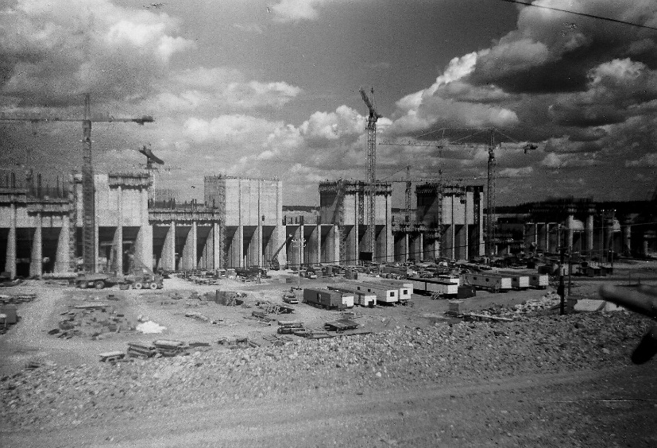

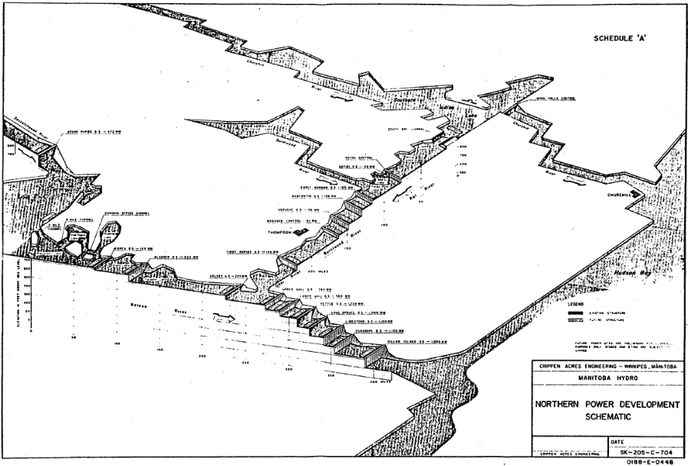
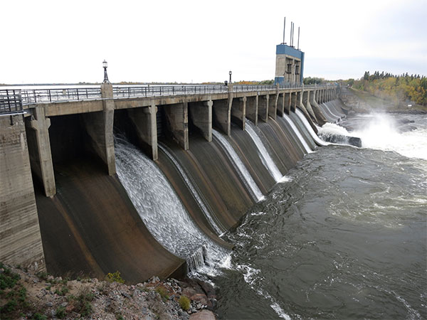
ASSUMPTION #1: ISONOMY
18 AGREEMENTS
BETWEEN 1990 AND 2010
≈ 1 PER YEAR
STRESSFULL, COSTFUL,
UNEQUAL, UNFAIR...

Slide 12
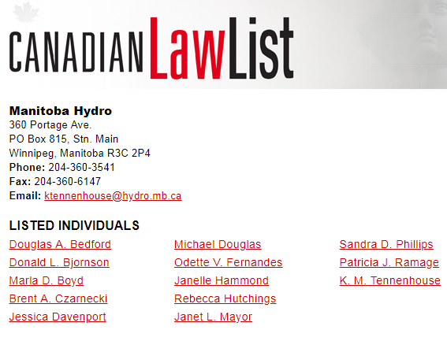
WHY UNFAIR?

Slide 13
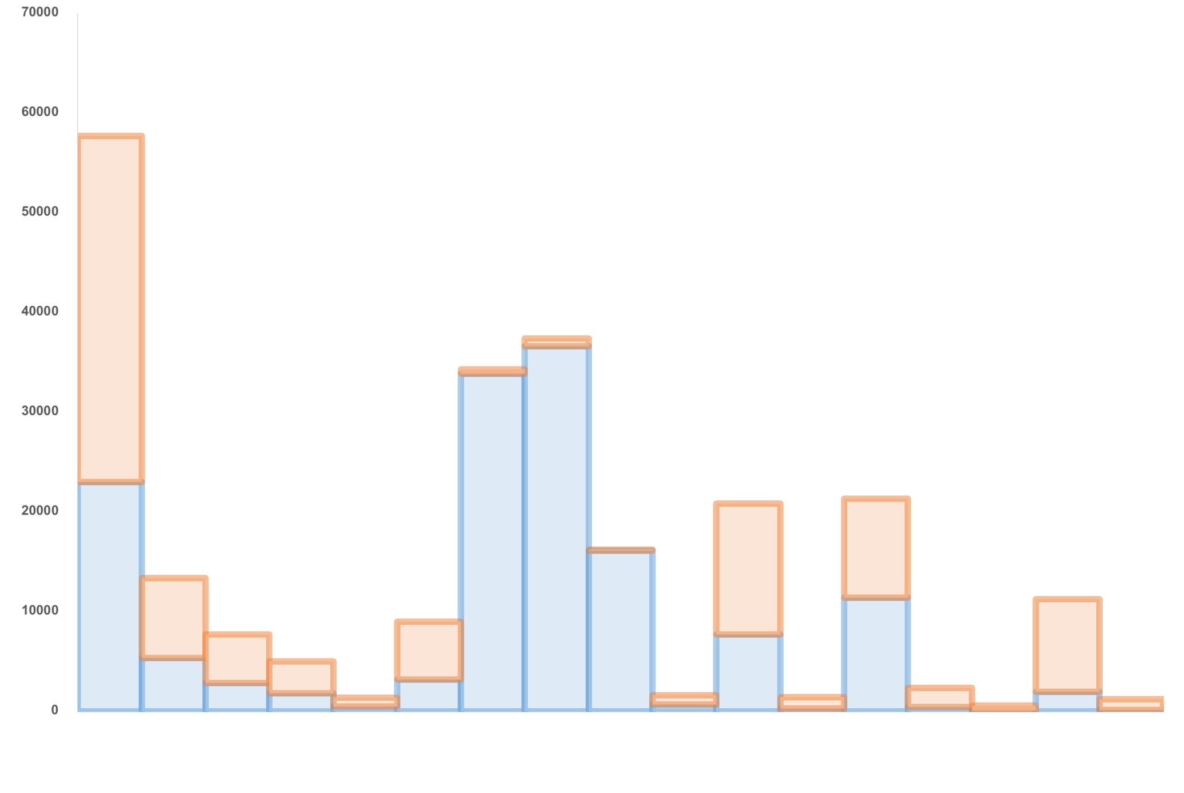
WHY UNEQUAL?
PER CAPITA PAYMENTS IN CURRENT CANADIAN DOLLARS
1990 Moose Lake
1996 Nelson House
1995 York Factory (NFA)
OTHER (MB, CA)
2004 Fox Lake / Keewatin
2006 Pickerel Narrows / Granville Lake
1997 Norway House (NFA)
1992 (Split Lake (NFA) / Tataskweya)
1990 Chemawawim / Easterville
2005 War Lake
1991 The Pas (Opaskwayak Cree Nation)
1991 Cormorant
1991 Grand Rapids
2005 Moose Lake
2005 Nelson House
2004 Easterville
2010 Cross Lake
1998 Sagkeeng
MH

Slide 14

ASSUMPTION #1: ISONOMY
IF THIS IS A PARTNERSHIP, THERE MUST BE OBJECTIVE TERMS TO DEFINE THE SIZE OF THE
MUTUAL BENEFITS
FLOODED AREA?
REMOVED PEOPLE?
SHAPLEY VALUE (1953)
IMPACT ON BUSINESS?

Slide 15

ASSUMPTION #1: ISONOMY BY CAPACITY
VALUES DUE TO SGK SHOULD BE PROPORTIONAL TO THE WEIGHT OF
WPGRSS (1978-2056) AS % OF MH HYDRO CAPABILITY
CURRENT CAPABILITY SHARE
NELSON (76%)
WINNIPEG (11%)
SASKATCHEWAN (9%)
BURNTWOOD (4%)
LAURIE (> 1%)
SOURCE: MH, COMPILED AND PRODUCED BY THE AUTHOR

Slide 16
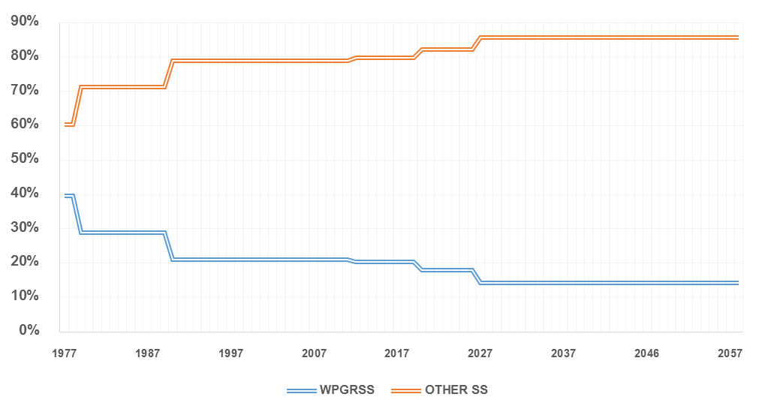
GENERAL ASSUMPTION #1: ISONOMY BY CAPACITY
WPGRSS AS % OF MH HYDRO CAPABILITY
SOURCE: MH, COMPILED AND PRODUCED BY THE AUTHOR

Slide 17
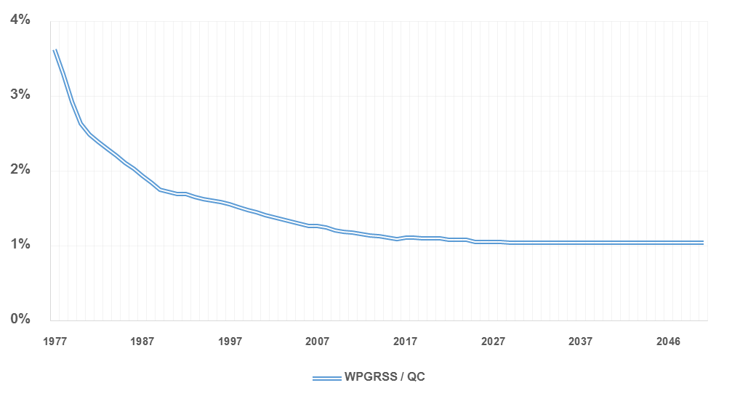
GENERAL ASSUMPTION #1: ISONOMY BY CAPACITY
WPGRSS AS % OF HQ CAPABILITY (FOR ESTIMATIONS OF MODELS 7-10)
SOURCE: MH, COMPILED AND PRODUCED BY THE AUTHOR

Slide 18
GENERAL ASSUMPTION #2: REVENUE
MH HYDRO REVENUE AND WPGRSS REVENUE (1978-2058)
BILLION DOLLARS
MILLION DOLLARS
FACTUAL
IFF17
3,5% / YEAR
SOURCE: MH, COMPILED AND PRODUCED BY THE AUTHOR

Slide 19
GENERAL ASSUMPTION #3: WATER RENTAL
MH HYDRO WATER RENTALS AND WPGRSS WATER RENTALS (1978-2058)
WHY? ARBITRARY?
MILLION DOLLARS
MILLION DOLLARS
FACTUAL
IFF17
5,5% / YEAR
(CAGR 1978-2017)
SOURCE: MH, COMPILED AND PRODUCED BY THE AUTHOR

Slide 20
ADDITIONAL ASSUMPTIONS
ECONOMIC ASSUMPTIONS
1978-2017: CONSUMER PRICE INDEX (CPI)
2017-2058: 2% / Y INFLATION RATE
KEEYASK (2020), CONAWAPA (2027) AND 6 DAMS IN QUEBEC (2020-2030)
MODELS 9 & 10 ASSUME 3.3% ANNUAL INCREASE OF OUTPUT (= AVG 5 LAST YEARS ACNR)
ZERO DEMOGRAPHIC GROWTH IN FORT ALEXANDER/SAGKEENG
COMMUNITY REVENUE ALTERNATIVES GROW AT SAME RATE AS INFLATION (=ZERO REAL GROWTH)
POLITICAL ASSUMPTIONS
RECONCILIATION: MH AND MB ARE WILLING TO COMPENSATE UNFAIR GAINS FROM THE PAST
NATION TO NATION: MH AND MB RECOGNIZE SGK AS AN EQUAL STAKEHOLDER IN AN UNEQUAL PARTNERSHIP
CO-MANAGEMENT: MH AND MB ARE ENGAGED IN SHARING BENEFITS AND NOT RISKS

Slide 21
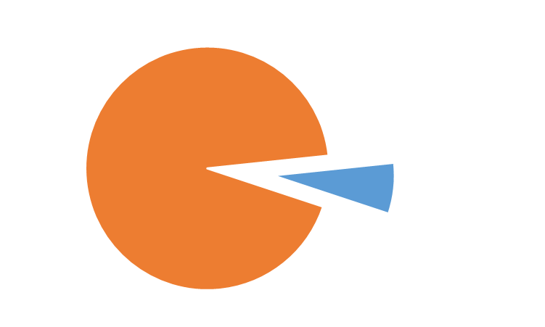
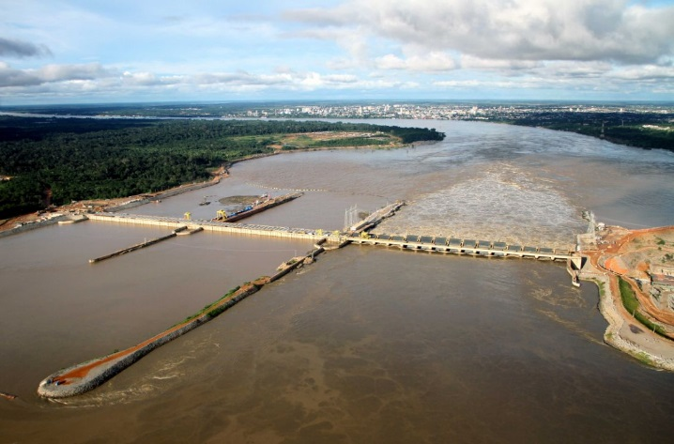
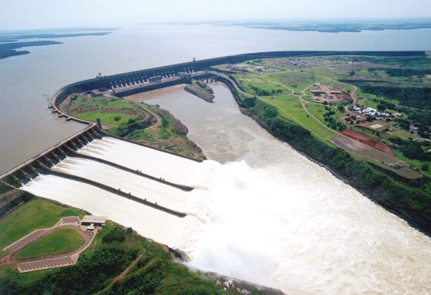
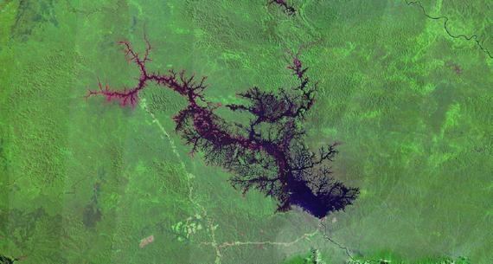
THE BRAZILIAN EXPERIENCE
6.75%
45% GOES TO AFFECTED
COMMUNITIES

Slide 22
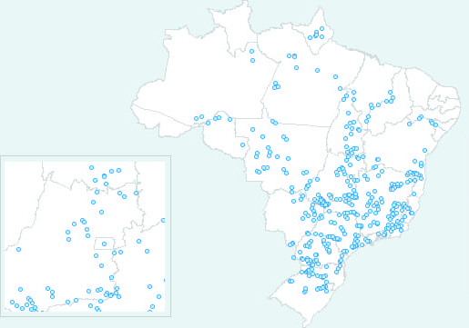
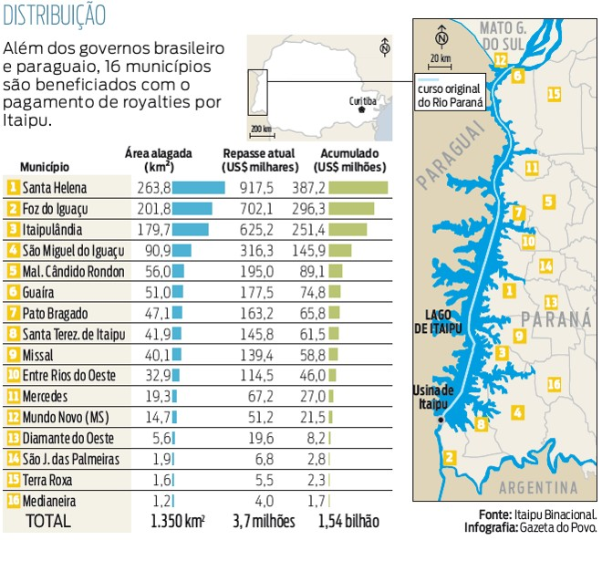
THE BRAZILIAN EXPERIENCE
EXTERNALITY
ROYALTIES
ISONOMY
1 LAW | 189 DAMS 710 MUNICIPALITES
12% OF ALL CITIES

Slide 23
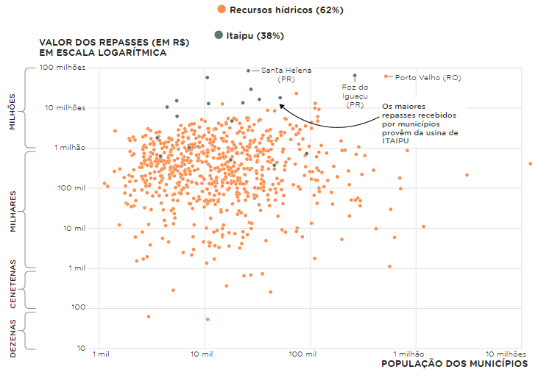
THE BRAZILIAN EXPERIENCE
SOURCE: NEXO JOURNAL

Slide 24
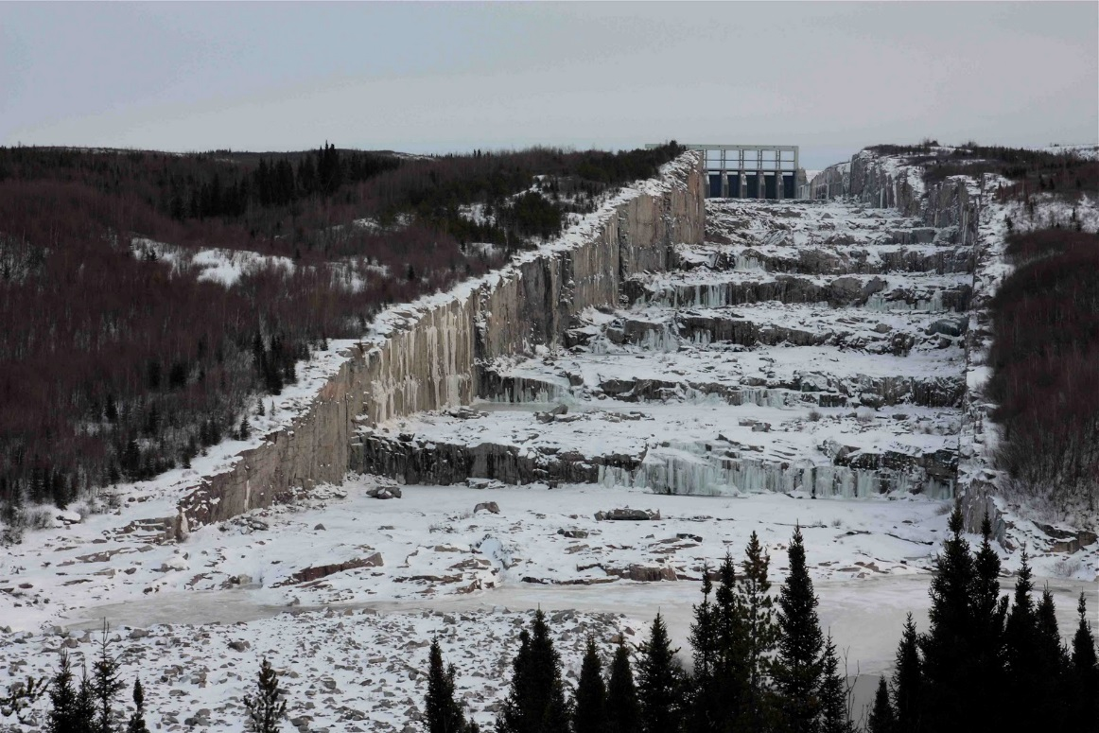
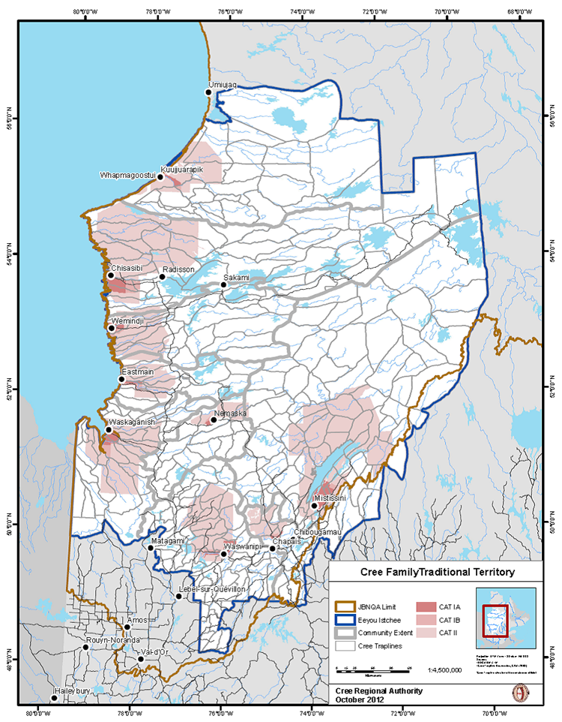
THE QUEBECER EXPERIENCE
11 DAMS
8 COMMUNITIES
1 AGREEMENT

Slide 25
COMPARING THE MODELS
VALUE OF THE DEAL (IN C$2017)
THIS IS WHAT
SAGKEEN WOULD
RECEIVE IF THEY
WERE IN THE
JAMES BAY AREA
(VARIABLE VALUE)
THIS IS WHAT
THE DEAL
WOULD LOOK
LIKE IF MB
GAVE ALL
WATER RENTALS
TO SAGKEEN
THIS IS WHAT
THE DEAL WOULD
LOOK LIKE
WERE MH
SUBJECT
TO BRAZILIAN
LAWS
THIS IS WHAT
SAGKEEN WOULD
RECEIVE IF THEY
WERE IN THE
JAMES BAY AREA
(FIX VALUE)
THIS THE MEAN
VALUE BETWEEN
ALL PROPOSED
ALTERNATIVES
THIS IS THE
CURRENT OFFER
MH
BR
MB
QC^{F}
QC^{V}
AVG

Slide 26
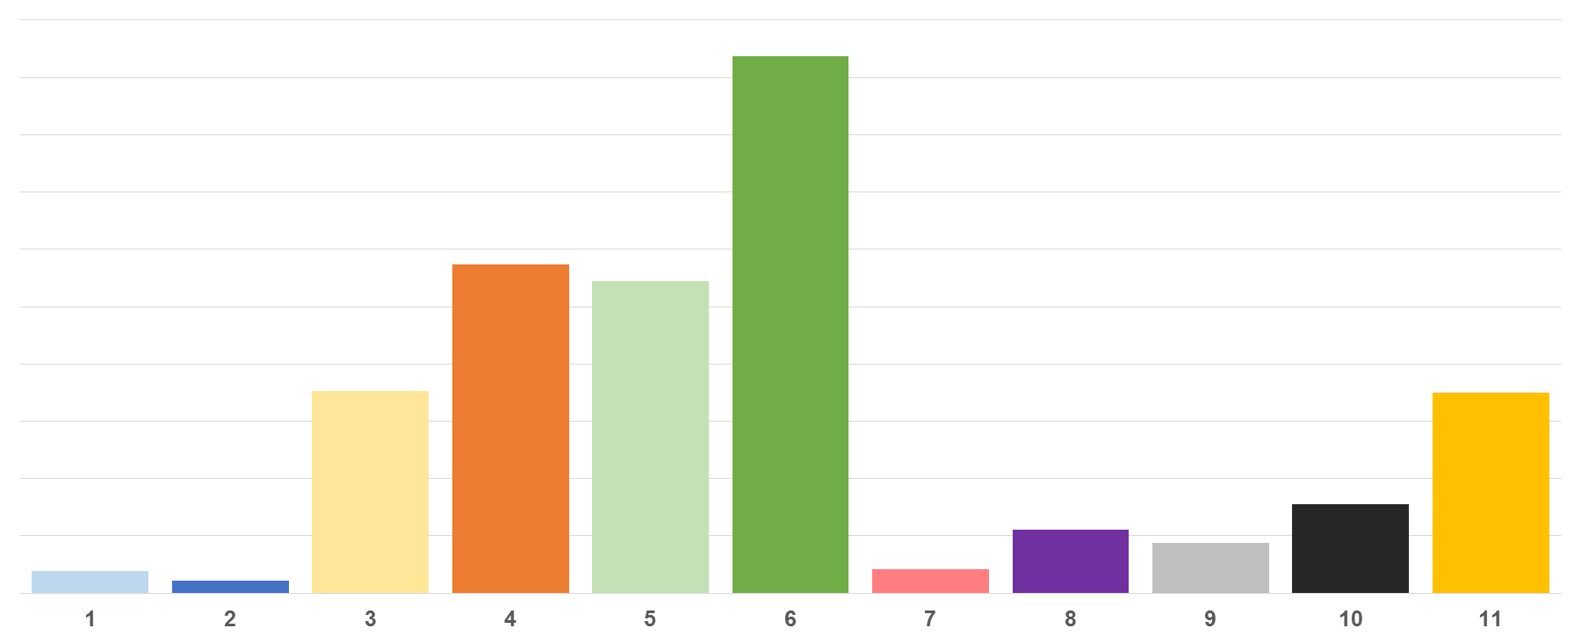
COMPARING THE MODELS
VALUE OF THE DEAL (IN C$2017)
996.3
608.8
583.9
376.7
MILLION DOLLARS
350.3
155.7
115.6
87.9
38.9
20.9
44.4
MH
BR
MB
QC^{F}
QC^{V}
AVG
SOURCE: COMPILED AND PRODUCED BY THE AUTHOR

Slide 27
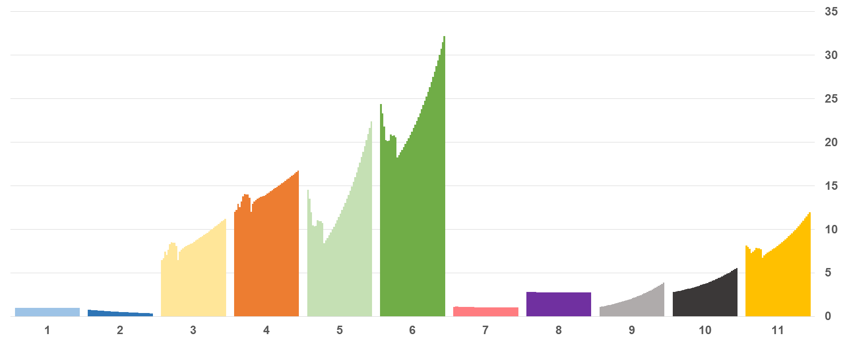
COMPARING THE MODELS
PROJECTED PAYMENTS (2017-2058)
MILLION DOLLARS / YEAR
MH
BR
MB
QC^{F}
QC^{V}
AVG
SOURCE: COMPILED AND PRODUCED BY THE AUTHOR

Slide 28




THE MEANING OF THOSE VALUES
COMPARING MH/BS1 DEAL WITH ALTERNATIVE EXISTING REVENUE RESOURCES
IN THE SGK COMMUNITY
CURRENT
PROPOSAL
ALTERNATIVE
PROPOSAL
SUPERSTORE
VLT
BINGO
TOTAL
38.9MI
350.3MI
417.1MI
72.1MI
64.3MI
AS %
COMMUNITY
REVENUE
(EX: 2018)
4.0%
35.7%
40.5%
7.4%
6.6%
SOURCE: FORT ALEXANDER (2013-2017)
PRODUCED BY THE AUTHOR

Slide 29
THE MEANING OF THOSE VALUES
COMPARING MH/BS1 DEAL WITH ALTERNATIVE EXISTING REVENUE RESOURCES
IN THE SGK COMMUNITY
CURRENT
PROPOSAL
ALTERNATIVE
PROPOSAL
SUPERSTORE
VLT
BINGO
TOTAL
38.9MI
350.3MI
417.1MI
72.1MI
64.3MI
PC/YEAR
IN $C (AVG)
121
1.092
1.238
224
201
PC/MONTH
IN $C (AVG)
10
91
103
18
16
SOURCE: FORT ALEXANDER (2013-2017)
PRODUCED BY THE AUTHOR

Slide 30
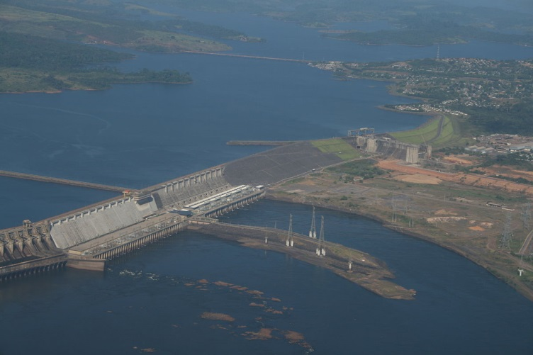
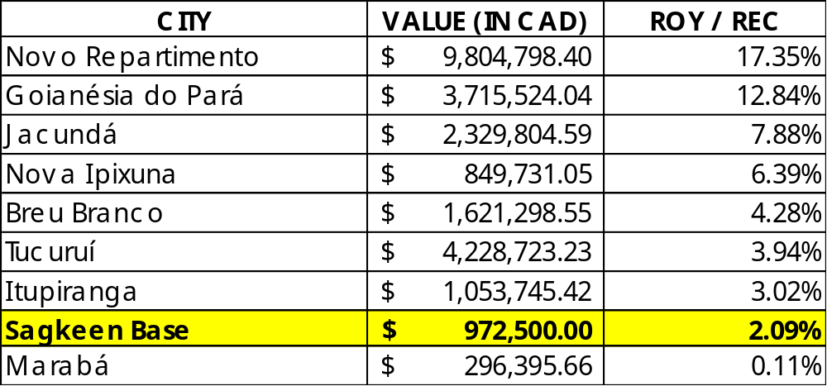
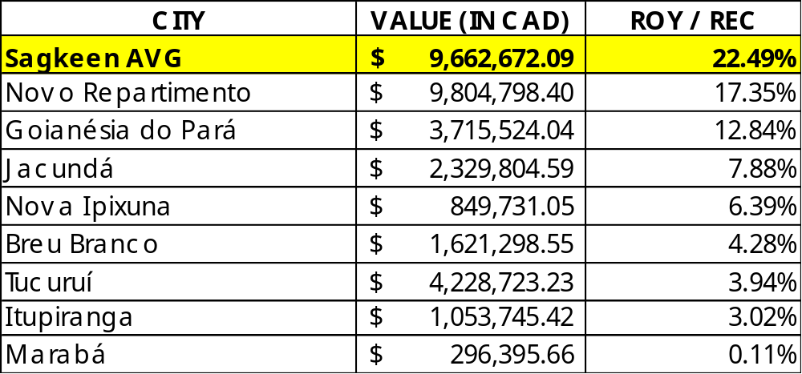
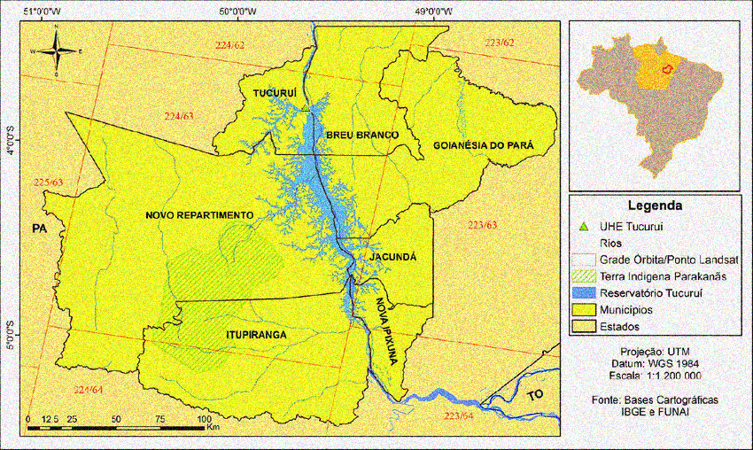
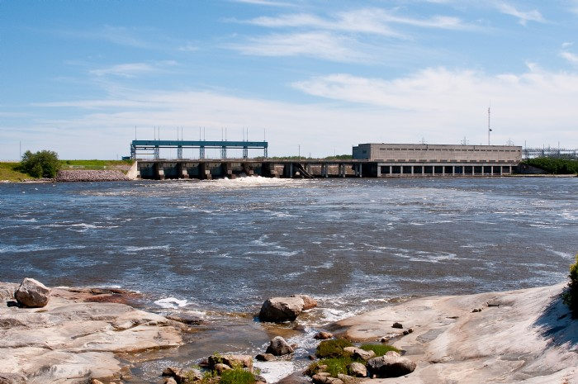
ALTERNATIVE MODEL
(38.9 MI UNTIL 2058)
MH CURRENT PROPOSAL
(38.9 MI UNTIL 2058)
MH BASE MODEL VS
TUCURUÍ DAM (BR)

Slide 31
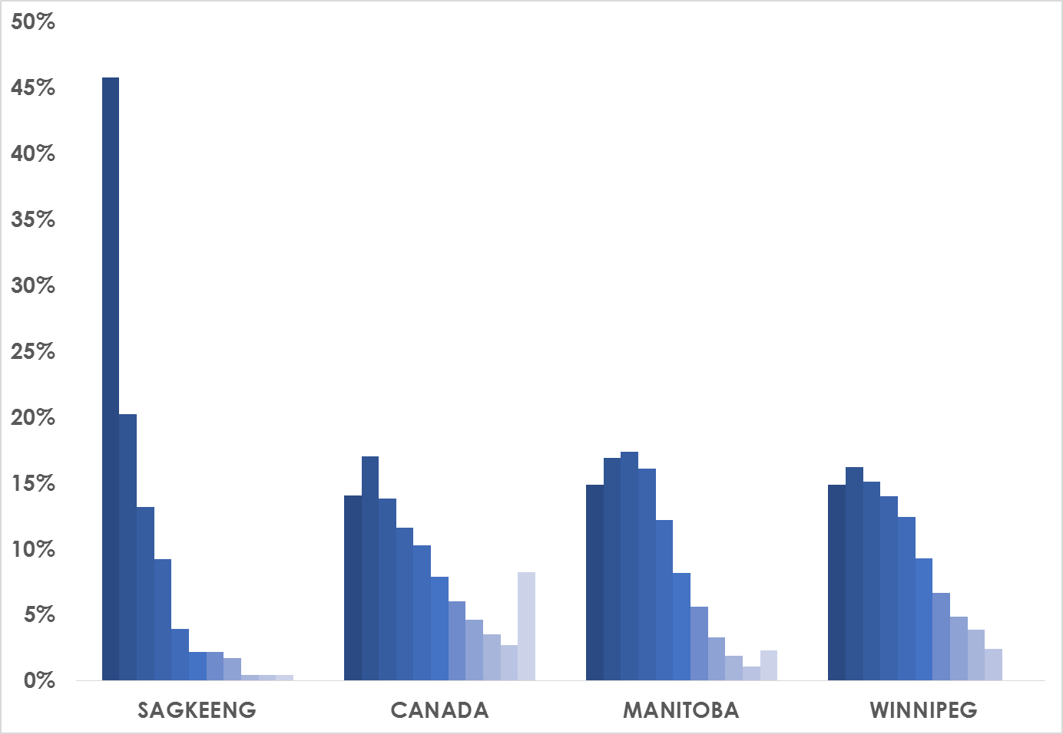
ADDITIONAL REASONS TO TRANSFER RESOURCES
COMPARATIVE PC ANNUAL INCOME DISTRIBUTION
1. Under $10,000
2. $10,000 to $19,999
3. $20,000 to $29,999
4. $30,000 to $39,999
5. $40,000 to $49,999
6. $50,000 to $59,999
7. $60,000 to $69,999
8. $70,000 to $79,999
9. $80,000 to $89,999
10. $90,000 to $99,999
11. $100,000 and over
SOURCE: STATSCANADA,
COMPILED AND PRODUCED BY THE AUTHOR

Slide 32
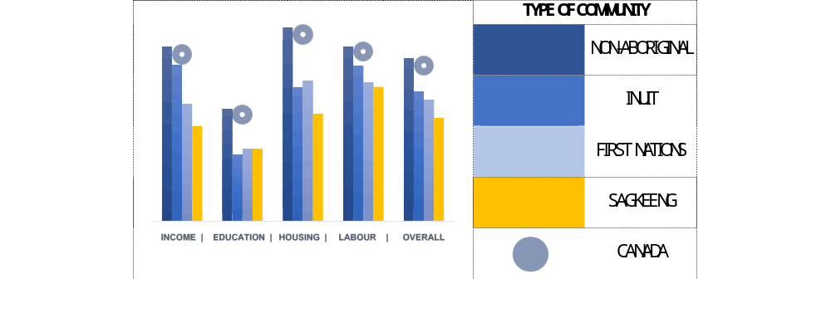
ADDITIONAL REASONS TO TRANSFER RESOURCES
COMMUNITY WELL-BEING (CWB) INDEX BY COMPONENT AND ETHNIC GROUP
SOURCE: AADNC,
COMPILED AND PRODUCED BY THE AUTHOR

Slide 33



ADDITIONAL REASONS TO TRANSFER RESOURCES
COMPARING MH/BS1 MI DEAL DESIMBURSEMENT WITH ALTERNATIVE COSTS
DIABETES
PATIENT
YOUTH IN
CUSTODY
ADULT IN
CUSTODY
MH/BS1
AVG
PC/YEAR
IN $C (AVG)
121
1.136
1.824
51.742
81.820
PC/MONTH
IN $C (AVG)
10
95
152
4.312
6.760
SOURCE: DIABETES CANADA &
PUBLIC SAFETY CANADA (2016)

Slide 34
RECOMMENDATIONS: NON-MONETARY PAYMENTS
INCLUSION OF NON-MONETARY PAYMENTS IN COMMUNITY DEALS DOES NOT ALIGN WITH BEST PRACTICES
NON-MONETARY PAYMENTS SHOULD NOT BE INCLUDED ON DEALS
NON-MONETARY PAYMENTS ARE IMPORTANT, BUT ESSENTIALLY SPORADIC AND/OR SEASONAL. THIS MEANS THAT HARDLY THIS MECHANISM WILL PROVIDE FINANCIAL RELIEF FOR SMALL/IMPOVERISHED COMMUNITIES

Slide 35
RECOMMENDATIONS: MONETARY PAYMENTS
PROPORTIONALITY IS ONE (AMONG SEVERAL) METHODS TO PRODUCE ARM’S LENGHT, PROVINCE-WIDE DEALS
AND COULD BE DEPLOYED TO QUANTIFY VALUES DUE TO HETEROGENOUS SYSTEM CAPABILITY
MODELS BASED ON VARIABLE (NON-NEGATIVE) PAYMENTS TEND TO HAVE LONGER, LONG-LASTING EFFECTS
MB & MH COULD AND SHOULD ABOLISH PRACTICES WHICH CAUSE EXCESSIVE FINANCIAL STRESS ON SMALL/IMPOVERISHED COMMUNITIES (E.G., RISK-SHARING VIA EQUITY ARRANGEMENTS, LOANS ETC.)

Slide 36
RECOMMENDATIONS: POLICIES
AD-HOC (‘PER-COMMUNITY’) ARRANGEMENTS DO NOT ALIGN WITH SECTORAL BEST PRACTICES
MB & MH SHOULD TRANSITIONATE TOWARDS A MORE SUSTAINABLE MODEL
AN ENHANCED FINANCIAL ANALYSIS WOULD NEED TO CONSIDER ADDITONAL REGULATORY SPECIFICITIES. SGK (PREFERABLY JOINTLY WITH OTHER AFFECTED COMMUNITIES) COULD OBTAIN ADDITIONAL RESEARCH RESOURCES FOR PROPOSING, IMPLEMENTING AND MONITORING REPORTS.
FINALLY, ON THE SPIRIT OF THE NATION-TO-NATION AND CO-MANAGEMENT PRINCIPLES, MB & MH COULD AND SHOULD BE COMITTED WITH A GRRS MODEL THAT TRULLY SUPPORTS LOCAL SOCIOECONOMIC DEVELOPMENT

Slide 37
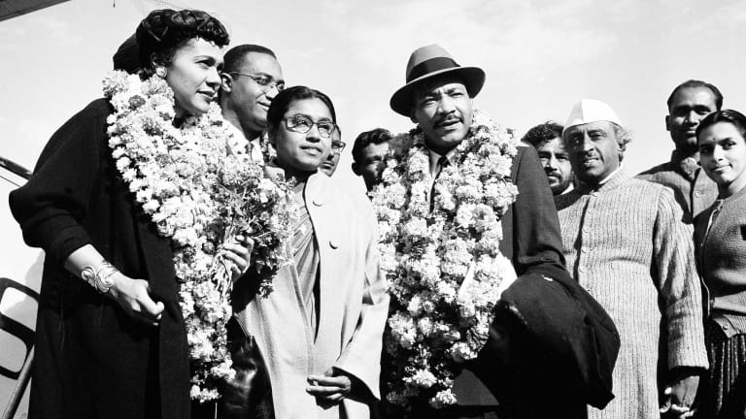
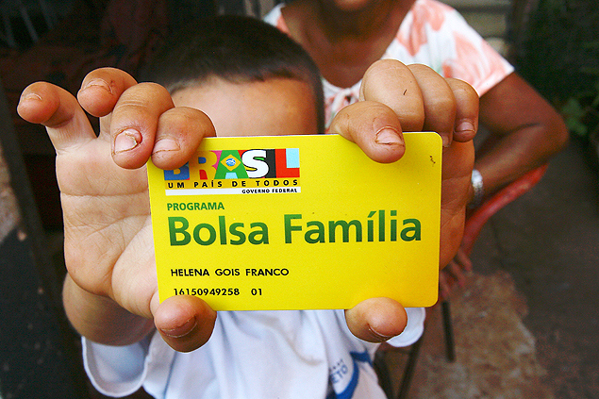
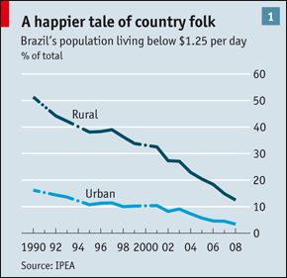
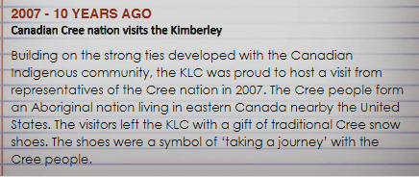
POTENTIAL CRITICISM #1:
THIS IS CANADA!... THERE IS NOTHING TO LEAR FROM THIRD WORLD COUNTRIES!

Slide 38
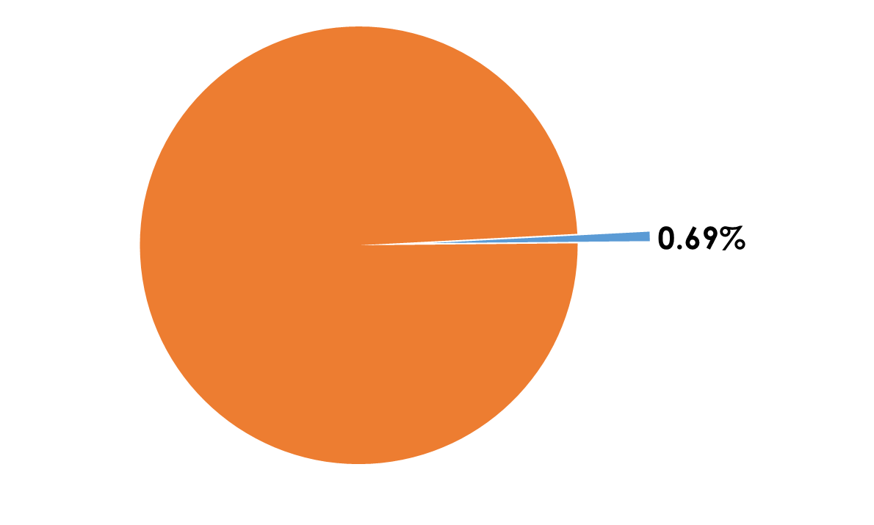
POTENTIAL CRITICISM #2:
IT IS NOT WISE! REVENUE SHARING IS
TOO RISKY!
POTENTIAL CRITICISM #3:
WHAT IF ALL AFFECTED COMMUNITIES DEMAND
THEIR SHARE ON WATER RENTAL REVENUES TOO!
THE PROVINCE’S BUDGET WILL COLAPSE!
FITCH RATING TO SOME
BRAZILIAN ELECTRIC COMPANIES
ENGIE Brasil Energia AAA
CPFL AAA
Belo Monte AA
COPEL AA-
2018 BUDGET CONTRIBUTION
OF WATER RENTALS
IN PROVINCIAL REVENU

Slide 39


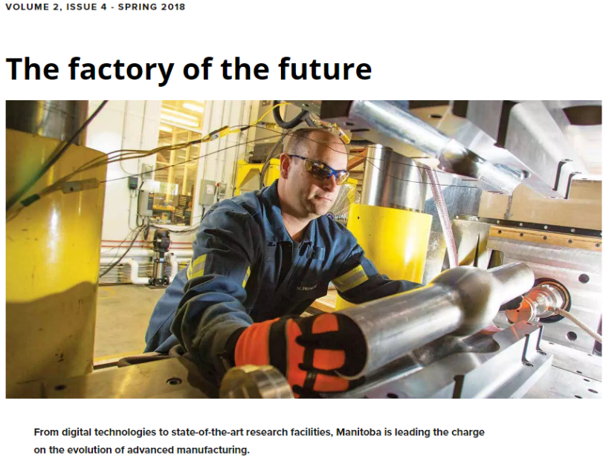



POTENTIAL CRITICISM #4:
RECONCILIATION? THIS IS THINKING BACKWARDS! WHY NOT THINK ABOUT THE FUTURE?

Slide 40
THANK YOU!

Slide 41
FLOOD AGREEMENTS 2.0
RESOURCE REVENUE SHARING, INNOVATIVE FINANCE AND ECONOMIC RECONCILIATION IN HYDRO-AFFECTED INDIGENOUS COMMUNITIES IN MANITOBA
PARTIAL REPORT
JULIO LUCCHESI, PhD
MARCH 2019

